Slide 1
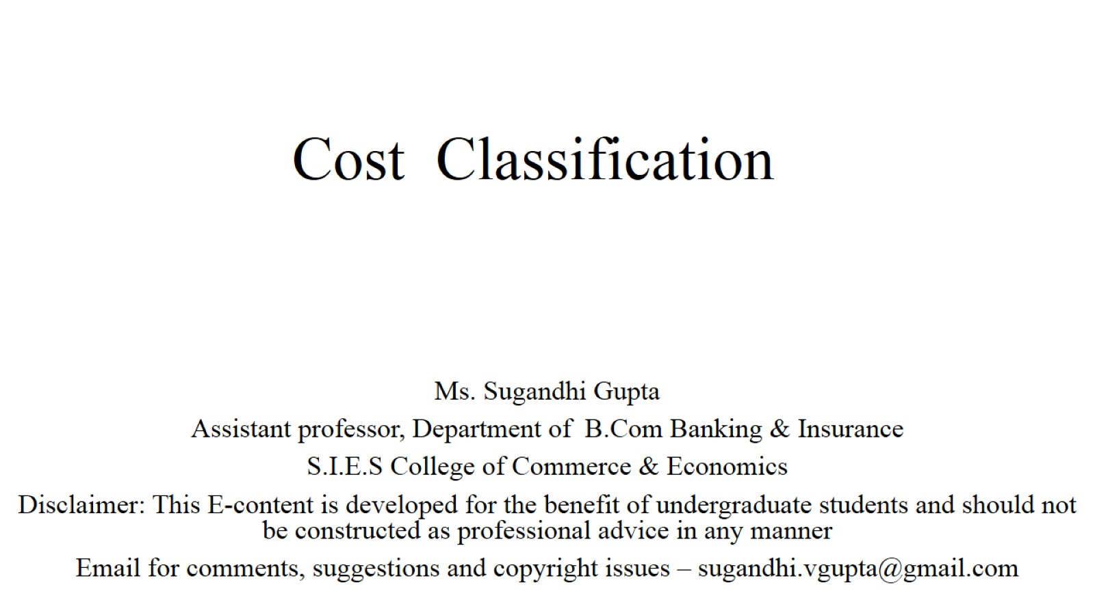
Cost Classification

Slide 2
Cost Vs. Expenses

Slide 3
Loss:

Slide 4
Loss:

Slide 5
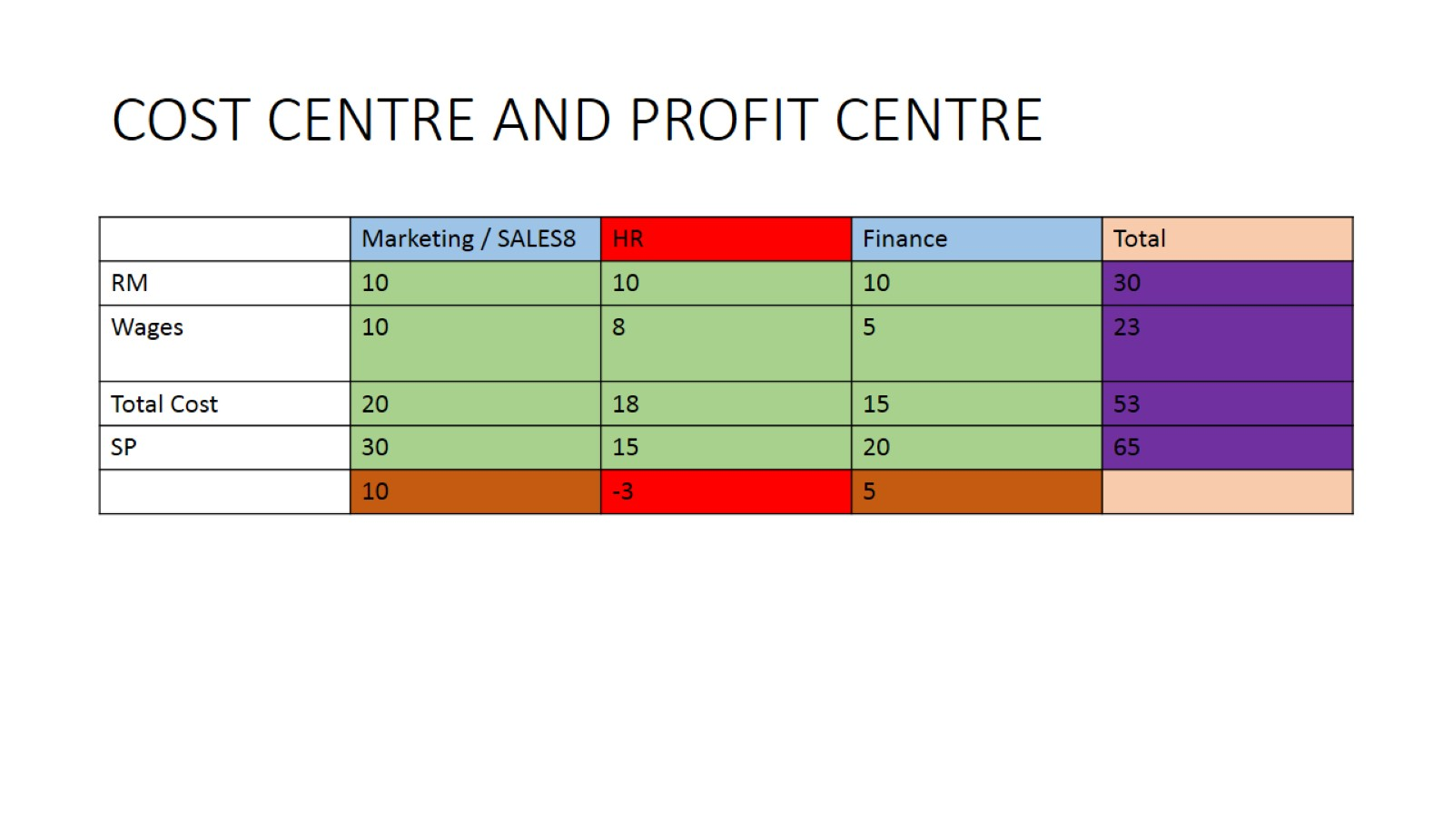
COST CENTRE AND PROFIT CENTRE

Slide 6
Cost Classification

Slide 7
Cost Classification

Slide 8
On basis of : Normal / Elements/ Relation with product

Slide 9
On basis of : Normal / Elements/ Relation with product

Slide 10
On basis of : Normal / Elements/ Relation with product

Slide 11
According to Variation in Production Activity and Quantity:

Slide 12
According to Variation in Production Activity and Quantity:

Slide 13
According to Variation in Production Activity and Quantity:

Slide 14
According to Variation in Production Activity and Quantity:

Slide 15
According to Variation in Production Activity and Quantity:

Slide 16
According to Variation in Production Activity and Quantity:

Slide 17
According to Functional Classification of Costs:

Slide 18
Other concepts

Slide 19
References

Slide 20
Thank You

